Slide 1




PowerShell for Office 365 Administrators
@ralpje

Slide 2

Ralph Eckhard
IT Consultant / Office 365 Specialist
Hands on
@ralpje
www.365dude.nl
@ralpje

Slide 3

Arrrrrrrr you ready?
@ralpje

Slide 4
Office 365
Tenant
Azure Active Directory
Exchange Online
SharePoint / OneDrive
Skype for Business
@ralpje

Slide 5
Office 365
MSOL Sign-in assistant (https://www.microsoft.com/en-us/download/details.aspx?id=41950)
$UserCredential = Get-Credential
Connect-MsolService -Credential $UserCredential
@ralpje

Slide 6
Exchange Online
$Session = New-PSSession -ConfigurationName Microsoft.Exchange `
-ConnectionUri https://outlook.office365.com/powershell-liveid/ `
-Credential $UserCredential -Authentication Basic –AllowRedirection
@ralpje

Slide 7
Azure Active Directory
Install-Module AzureAD
Connect-AzureAD -Credential $UserCredential
@ralpje

Slide 8
SharePoint Online
Sharepoint Online Managent Shell
https://www.microsoft.com/en-us/download/details.aspx?id=35588
Connect-SPOService -Url https://365dude-admin.sharepoint.com `
-credential $UserCredential
@ralpje

Slide 9
Skype for Business
SfB Online Powershell Module
https://www.microsoft.com/en-us/download/details.aspx?id=39366
$sfbsession = New-CsOnlineSession -Credential $UserCredential -Verbose
import-pssession $sfbsession
@ralpje

Slide 10
Office 365 Tips
Gebruik CSV-files als basis voor je tenant
Script, script, script
@ralpje

Slide 11
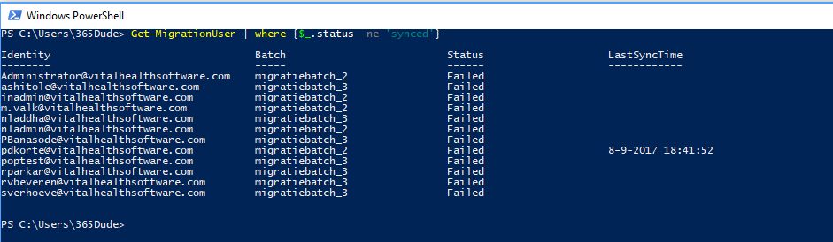
Office 365 Tips
@ralpje

Slide 12
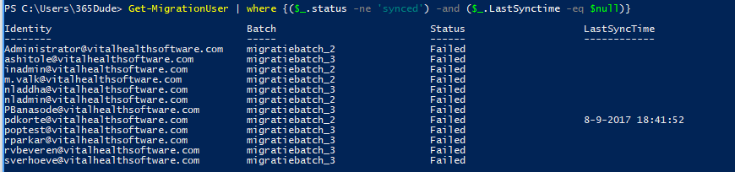
Office 365 Tips
@ralpje

Slide 13
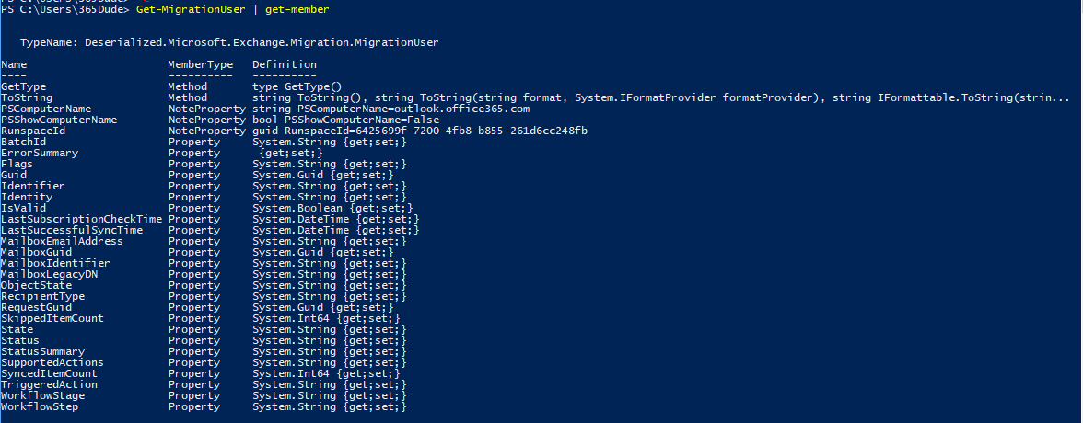
Office 365 Tips
@ralpje

Slide 14
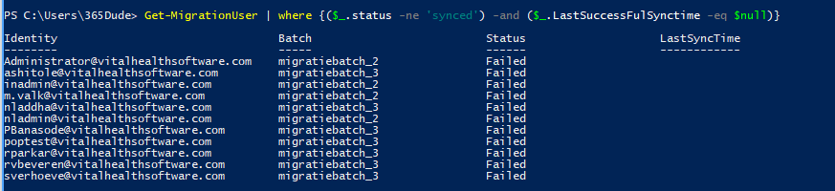
Office 365 Tips
@ralpje

Slide 15
Office 365 Tips
Get-Help
Get-Command
Get-Member
@ralpje

Slide 16
Vragen?
@ralpje

